Slide 1


Unit 3: Culture spot 4
London attractions

Slide 2


Slide 3
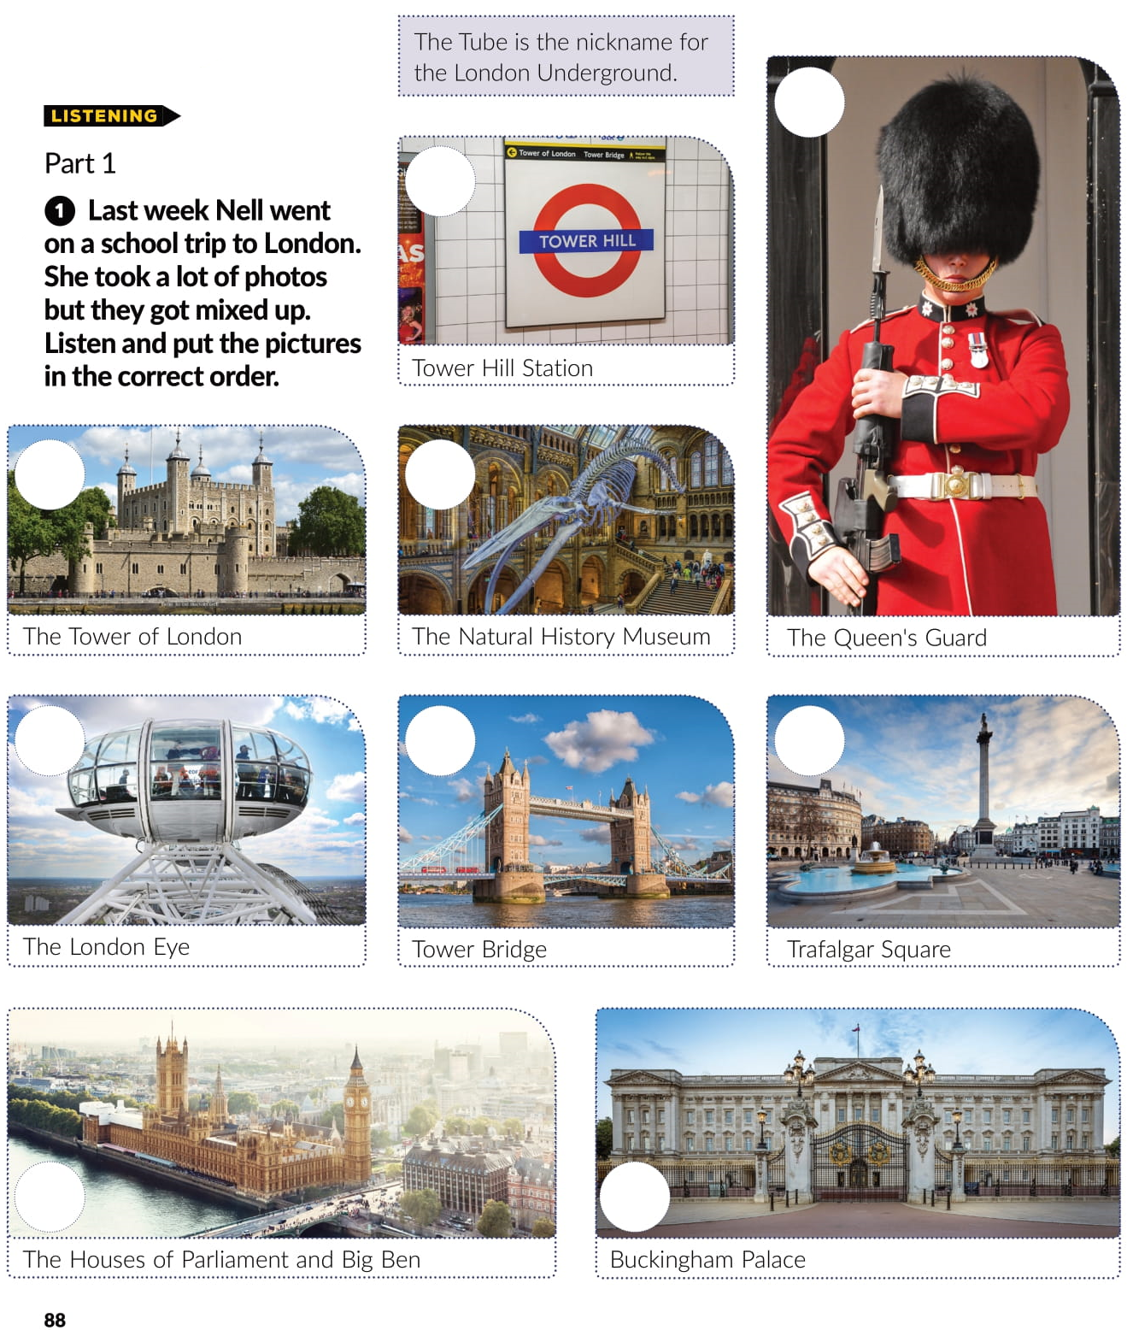

3
8
7
1
4
6
9
5
2

Slide 4
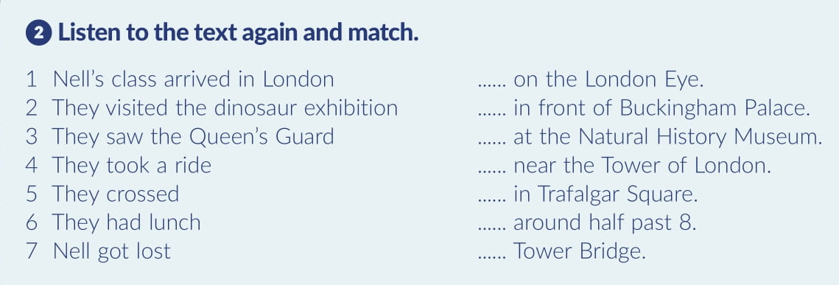

4
3
2
7
6
1
5

Slide 5
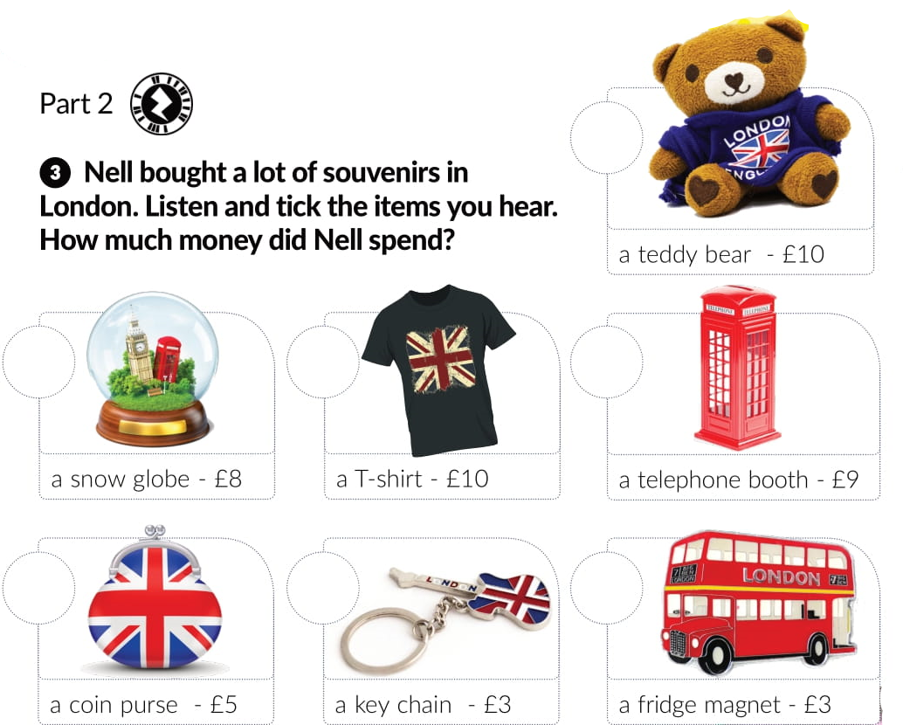


Slide 6
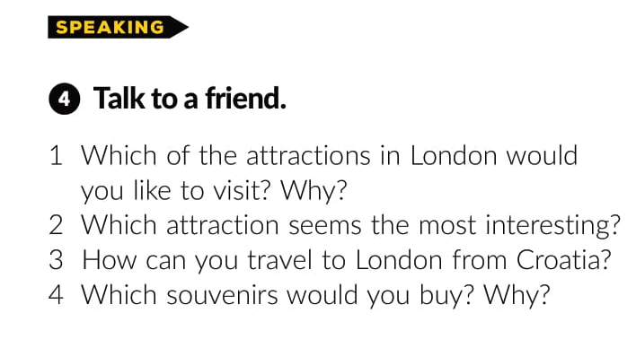
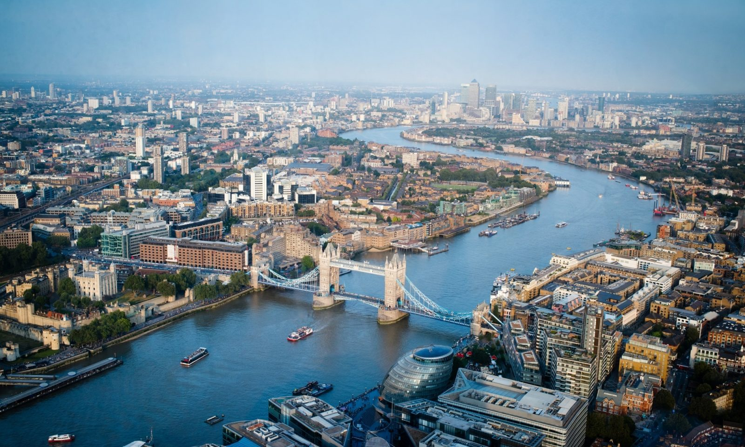
This Photo by Unknown Author is licensed under CC BY-SA-NC

Slide 7
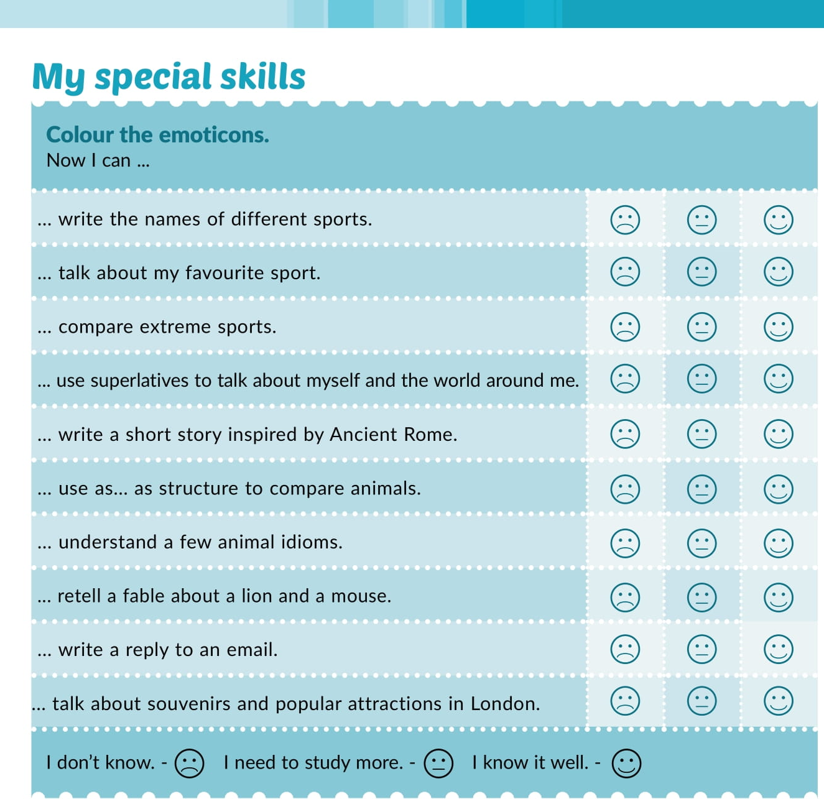

Slide 8
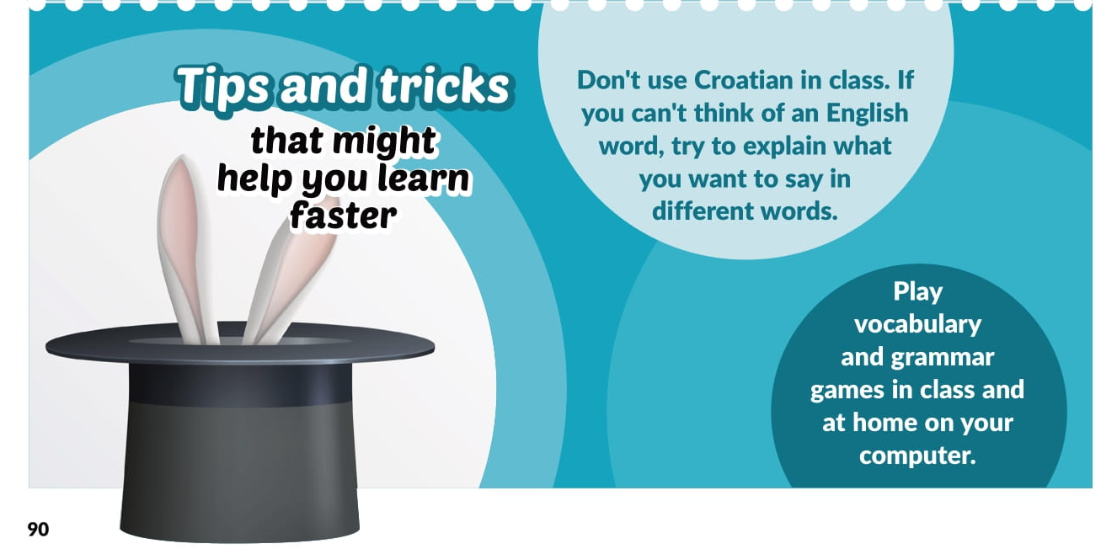

Slide 9

LEARN MORE
https://www.e-sfera.hr/dodatni-digitalni-sadrzaji/03cde0fc-57d9-4390-b1ca-cec2d63b8b13/

